Slide 1
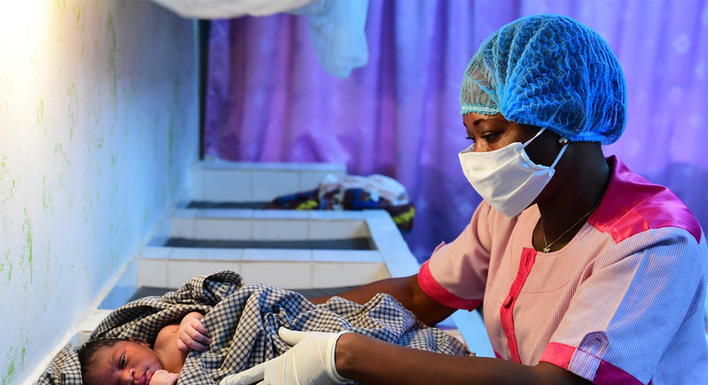

COVID-19 Knowledge, Attitudes and Practice (KAP) Survey Exploratory Analysis
Ministry of Health, GOSS
UNICEF South Sudan
and Evaluation Office
July 2020

Slide 2

Methodology
Household survey: one-on-one interview with the head of household
Direct observation and photographs
Data collection: ONA forms uploaded to a tablet or phone
Trainings conducted: 230 persons (175 Men and 55 women) across the country from partner organizations and UNICEF trained on data collection techniques using the Organizational Network Analysis (ONA) data collection tool.
Partner engaged in data collection and supervision: 22 partners from health, nutrition child sectors, WASH, cluster partners, IOM, UNCHR, engaged in data collection
Strict adherence to recommended COVID-19 prevention guidelines on physical distancing & wearing of facemasks.

Slide 3

KAP study questions (https://enketo.ona.io/x/#QnKjqsOC)
Questions on: Awareness, knowledge, attitudes and practices reported by households
Knowledge: knowledge on signs, symptoms, prevention and control
Attitudes towards:
individual agreement or willingness to participate in combating the epidemic (COVID-19) and
the trust in government/partners in winning the battle against COVID-19.
Practices were assessed against recommended COVID-19 safety, infection prevention and control guidelines, such as physical distancing, hand washing, and no handshaking

Slide 4
Implementation timelines
Tool development and ratification by RCCE TWG partners: May 2020
Inception report and tool finalization: May 18, 2020
Training of enumerators shall take place in the week of June 8th to June 12th 2020.
Data collection
June 15-30
Analysis
July 1-10

Slide 5
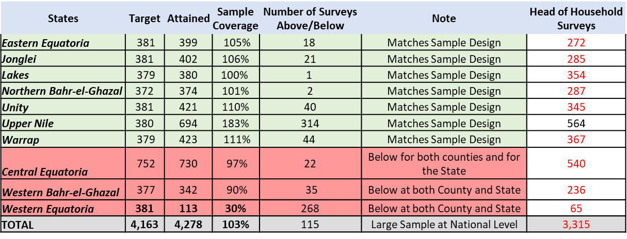
SAMPLE ANALYSIS
Design was completed for 70% of States (7) for all respondents
30% of States (3) did not complete state targets, for all respondents
38 counties (48%) have respondents but only 28 counties (35%) have a large enough sample > 32 respondents.
For the original targets, including a referential county, there are low target coverage in Yambio – 30% (W. Equatoria), Torit - 39% (E. Equatoria), and Rumbek - 47% (Lakes), rendering underrepresented samples for this targeted areas.
Therefore, the sample can provide aggregates and inferential analysis at the national level for the population of country beneficiaries, and depending on randomness of the respondent selection to the whole population. However, at the state and county level all analysis has to be more carefully approached.

Slide 6
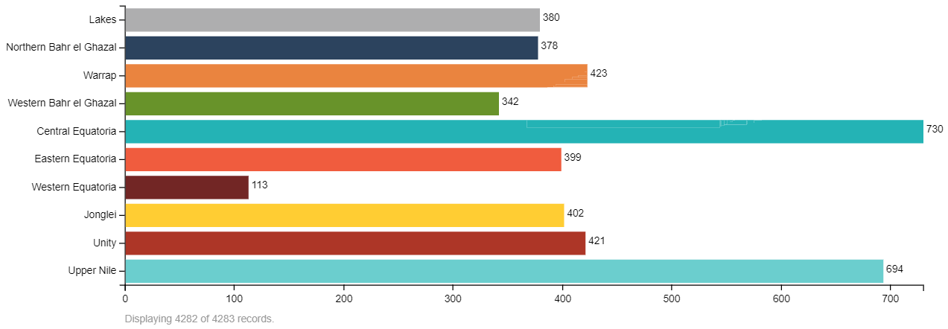
Geographic indicators 4278 households in 119 payams across 38 counties were reached as part of data collection exercise 207 staff and 22 partner agencies participated in this data collection exercise

Slide 7
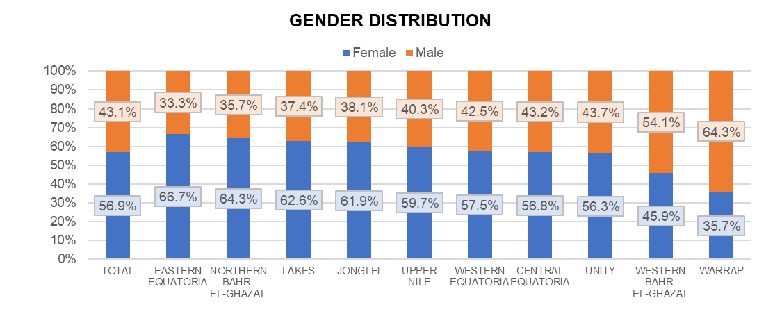
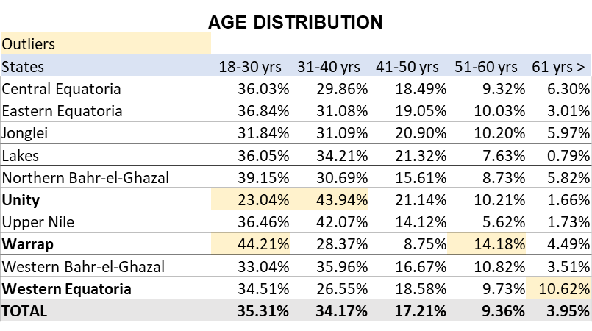
DEMOGRAPHICS – GENDER/AGE
Education levels vary greatly across states
Main takes:
Female caregiver participation is reasonably high at 56.9%, however less women caregivers participated in Western Bahr-El-Ghazal and Warrap
More men participate compared to women in online and call-center surveys indicating access and capacity challenges
69.5% caregiver respondents were between 18-40 years age group. 31.17% from the vulnerable case load age group. However significantly low participation among the 61+ age group.
There are outliers for age responses by State

Slide 8
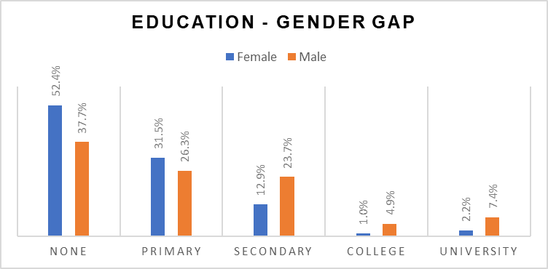
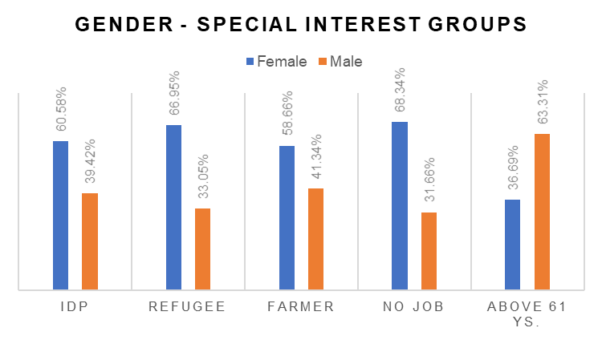
GENDER INSIGHTS - DISTRIBUTION
Women are over-represented with 57% of respondents. However, they are less educated cross all levels.
Main takes:
Women are well represented among all vulnerable groups
Significant education levels drop from primary to secondary and beyond (Social norms barrier)
Over-represented also on special groups, except above 61 ys.

Slide 9
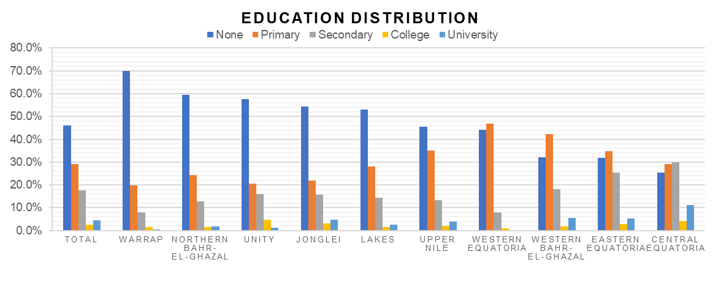
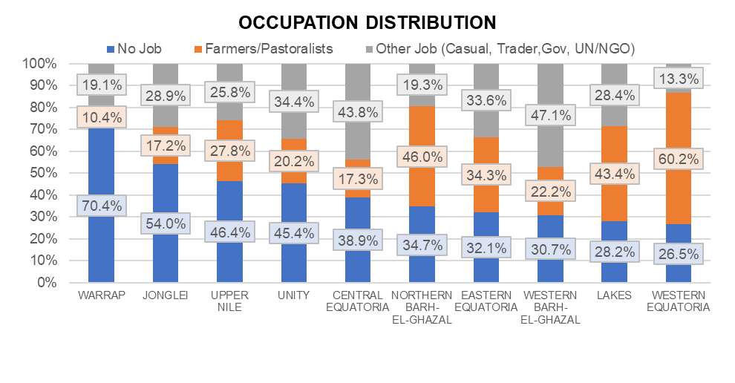
DEMOGRAPHICS – EDUCATION/OCCUPATION
Education levels vary greatly across states
Main takes:
46% caregivers were not literate, however significant caregiver respondents had some level of education – Jonglei, Unity, NBeG, Warrap hovering >50%
42.3% had no form of livelihood which has significant bearing on the individual behavioural uptake of CoVID-19 measures; 39% caregivers unemployed in Cent. Equa.
26.5% of the respondents were farmers/ pastoralists; 44% in CES are casual, trader category, a population group that should be highly mobile – vulnerable ???
Unemployment is more marked in a few areas

Slide 10
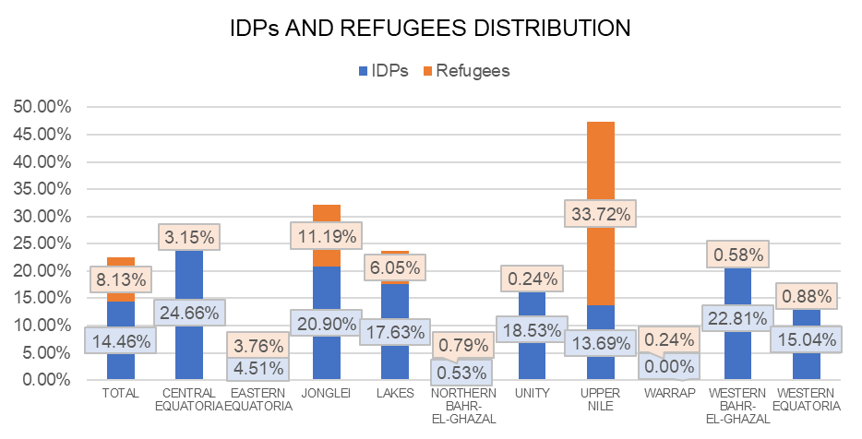
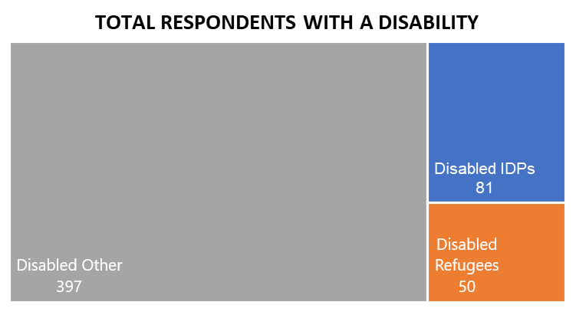
DEMOGRAPHICS – IDPs & REFUGEES/DISABILITIES
14.5% respondents are IDPs (619) and 8.13% are refugees (348)
Main takes:
23% respondents were IDPs and refugees
85.5% Christians and 4.8% Muslims
77.4% caregivers were heads of household; reasonably more women HHs
CoVID-19 risk communication and community engagement activities are INCLUSIVE
12.3% of all respondents have a disability (528).

Slide 11
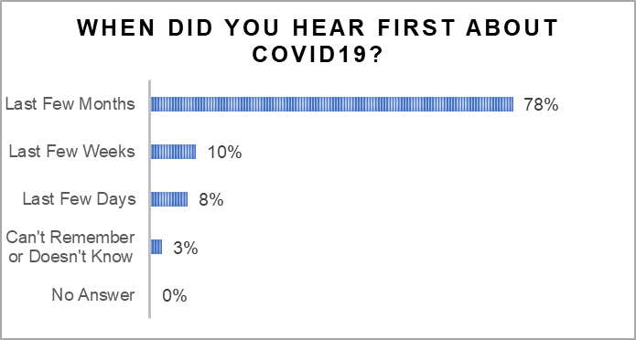
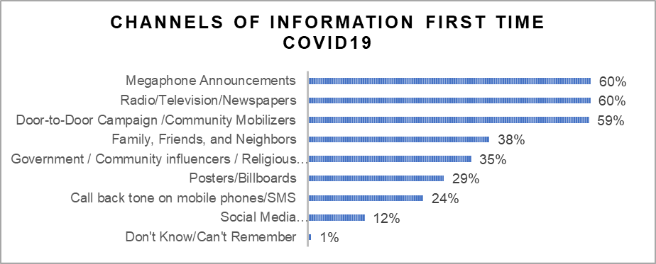
AWARENESS – FIRST TIME INFORMATION
About 99% of respondents heard about COVID-19.
Main takes:
Communities access to information is high; multi-channel approach is key in increasing population access to life-saving information
Information reach has been faster, farther and wider compared to EVD response
Door to door community mobilization, Radio and megaphone announcements are key communication channels
Religious leaders and community influencers had a significant role in information dissemination
Top three first-time information channels have +20% from next

Slide 12
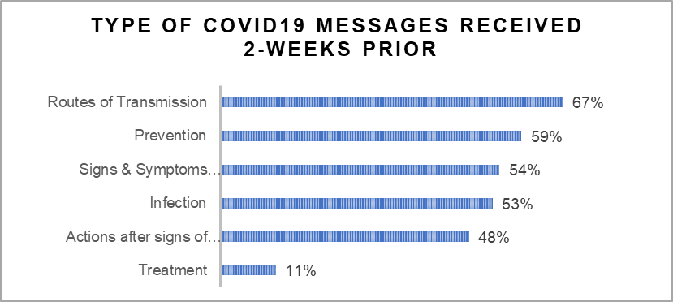
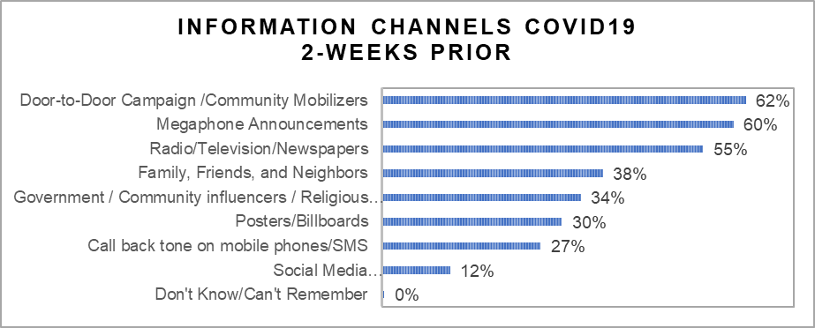
AWARENESS – RECENT INFORMATION
90% respondents heard COVID-19 messages 2-weeks prior
Main takes:
Information on treatment is significantly low among the population compared to uptake of other COVID-19 information.
Uptake for door to door mobilization has increased since beginning of RCCE outbreak response efforts
Community engagement efforts are increasing in recent past compared to mass media efforts
Top information channels maintain similar levels

Slide 13
GENDER INSIGHTS – COMMS. CHANNELS AND AGE
There are important variation from communication channels depending on age and gender (Green highlights the highest between the two groups compared)

Slide 14
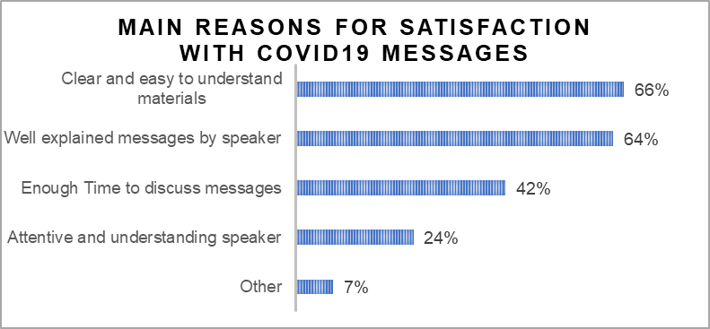
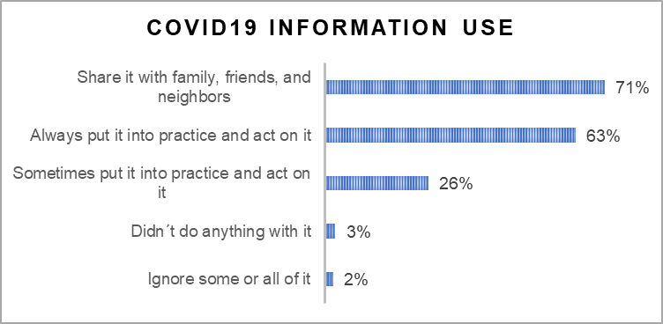
AWARENESS – SATISFACTION AND INFORMATION USE
92% were very/satisfied and 3% were very/dissatisfied
Main takes:
Satisfaction levels were high at 92%
Some indicated challenges of inferring complex CoVID-19 messages
63% of respondents believe that they put information into action indicative of positive intent among the population
Most respondents put into practice COVID19 messages

Slide 15
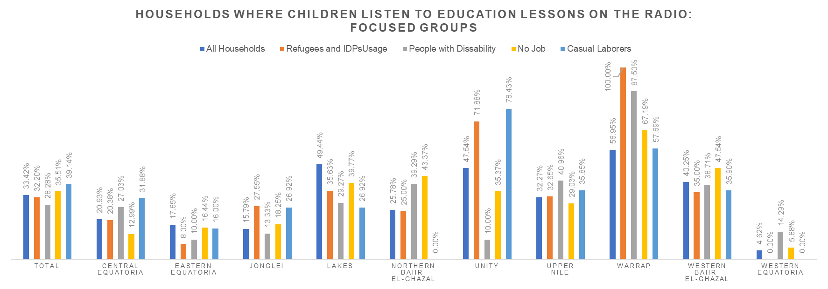
AWARENESS – DISTANCE LEARNING RADIO
50% doesn’t have a radio
Main takes:
Radio Education seems to vary greatly across the country and with more usage among specific groups
(This graph used only heads of households vs. individual level on previous graphs)

Slide 16
KNOWLEDGE – POSITIVE STATEMENTS
Knowledge Tested (T) = %True Response (F) = %False Responses | Nat'l Avg. | Group Avgs. of Concern
Handwashing with soap and water for 20 seconds | 98.79% (T) | NA
Avoid public transportation, crowded places and mass gatherings to prevent COVID19 infection | 94.77% (T) | Disability: 92.6% Refugees: 92.2%
Fever, dry cough, difficulty in breathing and tiredness are main symptoms of COVID19 | 94.23% (T) | No Education: 92.4% Above 61ys.: 88.8% Refugees: 88.2%
Stay at home or call hotline if exposed to person with COVID19 | 94.21% (T) | No Education: 92.2% Farmers: 92% Above 61ys.: 88.2%
Use of masks to prevent spread | 91.08% (T) | No Education: 87.7% Above 61 ys.: 86.4% Farmer: 85.5% Refugees: 84.5%
Main takes:
95% community knowledge on CoVID-19 measures with usage of masks at 91%
High knowledge levels among vulnerable population (refugees, above 61 years, no education, disabled etc.,)
However, 49% have poor knowledge on asymptomatic cases

Slide 17
KNOWLEDGE – NEGATIVE STATEMENTS
Main takes:
Around 60+% are well-informed on CoVID-19
Around 40% still are ignorant, exposed to rumours, mis-dis- information
Comparatively ignorance levels are higher than mis-dis information levels
Knowledge Tested (T) = %True Response (F) = %False Responses | Nat'l Avg. | Group Avgs. of Concern
Mosquitoes can transmit COVID19 | 65.69% (F) | Basic Education: 63.1% No Education: 61.5% Above 61 ys.: 59.7% Disability: 57% Farmer: 51.3% Refugees: 46.3%
Physical distancing cannot stop spread of COVID19 | 63.50% (F) | Above 61 ys. old: 59.8% No Job: 59.6% Age 51-60 ys.: 59.1% No Education: 58.77% Disability: 57.2% Refugee: 42%
Belief that there is cure for COVID-19 | 58.50% (F) | Disability: 54.4% No Education: 53.8% Farmer: 53.4% Above 61 ys.:52.7% Age 51-60 ys: 51.37% Refugee: 32.47%
There seems to be an effect of use of negative statements, as on average negative statements have 30% less than positive statements.

Slide 18
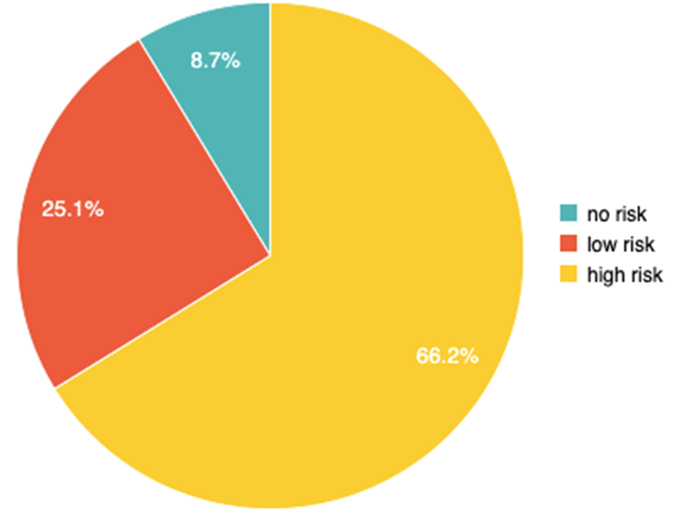
Attitudes Risk Perception
66% caregivers have high risk perception
25% caregivers have low risk perception
9% caregivers have no risk perception
Do you believe that you are at high risk, low risk or no risk to contract CoVID-19?
“People in South Sudan are not dying from COVID-19”
“I believed COVID-19 is not there because I have not seen a person suffering from it” (Erap village, Yei).
“Most of the people still want to see real evidence by seeing a real confirmed person for them to believe that the disease real exists” (Luparate village)
“I heard that the virus is only for the whites and brown people in Africa” (Luparate village)
3.9%

Slide 19
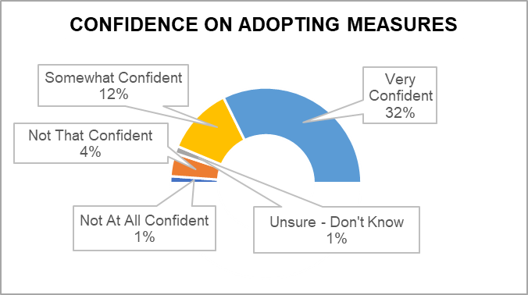
ATTITUDES
About 98% of respondents think is important to take action to prevent the spread of coronavirus
Main takes:
98% confident in adopting positive behaviour
Mis-trust is significantly high (44%) and its even higher in South Sudan (51%) indicative of lack of trust in the outbreak response measures. Similar findings seen during EVD response
However more recent evidences indicate that intent to action (uptake) is driven by social norms, humanitarian aid and trust on the national response (enabling environment)
56.1% of respondents believe that the world will overcome COVID19 and only 48.9% that South Sudan can win the battle vs. COVID19
Risk Perception | High Risk | Low Risk | No Risk
National | 66.21% | 25.11% | 8.69%
Above 61 ys. | 60.36% | 30.77% | 8.88%
Disabled | 69.13% | 23.86% | 7.01%
Refugee | 78.45% | 12.64% | 8.91%
Disabled IDPs and Refugees | 86.00% | 8.00% | 6.00%

Slide 20
GENDER INSIGHTS – ATTIDUES AND COMMS. CHANNELS
Above 61 ys. Old there are differences on attitudes
Main takes:
Around 60+% are well-informed on CoVID-19
Around 40% still are ignorant, exposed to rumours, mis-dis- information
Comparatively ignorance levels are higher than mis-dis information levels
Selected Variables | Female 61 ys | Male 61 ys
High Risk Perception | 54.84% | 63.55%
Own Mask | 33.87% | 27.10%
Use Mask | 30.65% | 23.36%
There are communication channels that are more gender neutral than others

Slide 21
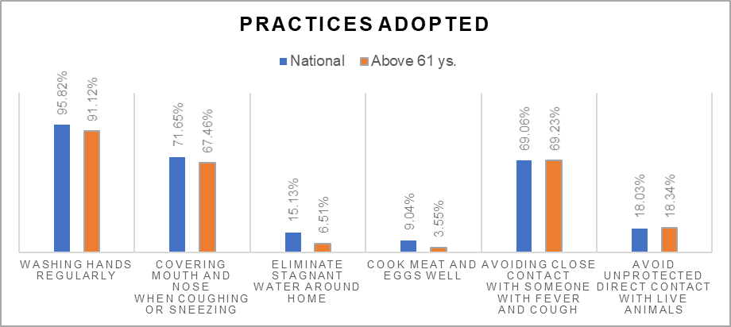
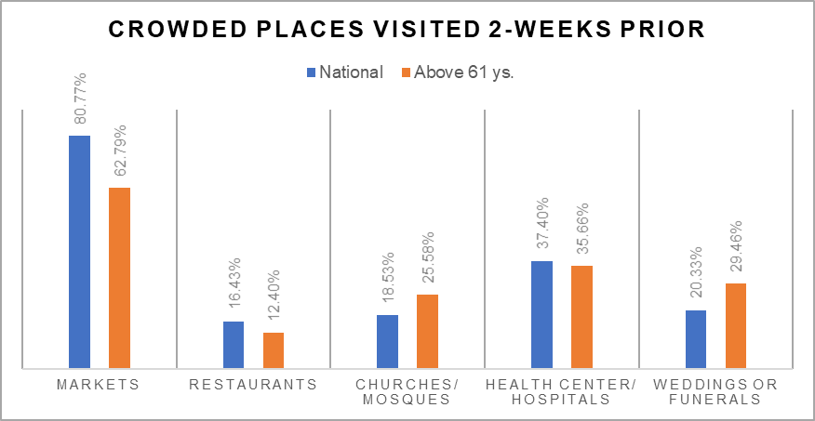
PRACTICES – UPTAKE AND CROWDED PLACES
100% of respondents have taken at least 1 protective practice
Main takes:
Handwashing, covering mouth and nose while coughing/sneezing, avoiding close contact with suspected cases are good practices exhibited by the respondents
86% have visited crowded places
Markets are the most visited places followed by health centers
Among elderly population – visits to churches/mosques and weddings/funerals are higher compared to national average
84.4% of respondents were in a crowded place 2-weeks prior

Slide 22
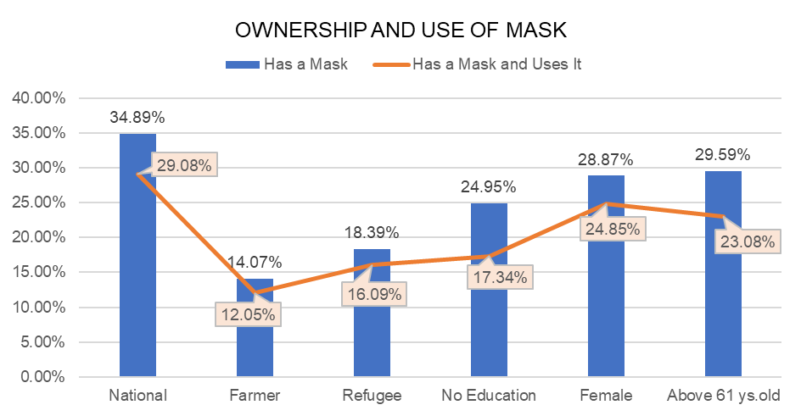
PRACTICES – MASK OWNERSHIP/USE AND OTHERS
Ownership and mask use varies greatly across groups
Main takes:
65% respondents do not have a face mask – supply barrier
83% indicate wearing a face mask as they own it seen among vulnerable population with lower uptake among ignorant communities
Other studies indicate significant lower uptake of wearing face masks among vendors in markets and service providers compared to general population – personal intent barrier
43% men own a facemask compared to 29% women – access barrier
45% shake hands and 67% eat in groups – social norm barrier
Additionally, 44.54% of respondents shake hands recently and 66.98% ate in a group with others.

Slide 23
PRACTICES – FOLLOW RECOMMENDED ACTIONS
Main takes:
Findings indicate risk perception certainly drives uptake of positive behaviours
Barriers for positive behaviour uptake include lack of economic support if tested positive, stigma, mis-dis-information and mistrust on the response efforts
Stigma is an underlying factor that drives mistrust against the response efforts
94.8% of respondents would follow recommended actions if symptoms show.
Reasons why not to follow recommendations if no symptoms present
I am not at risk | 13.9%
I don’t think I'll receive good health service | 24.1%
I don’t think is important | 16.58%
Other | 40.64%
N.A. | 4.81%

Slide 24
CONCLUSIONS
Drivers of positive behaviours – access to information, knowledge and risk perception complemented by enabling environment has supported hand washing, respiratory hygiene and self isolation behaviours
Globally CoVID-19 behavioural uptake is majorly driven by Govt. lock down with strict enforcement measures complemented by responsive mass and social media infrastructure
South Sudan behavioural uptake is mainly individual and community driven and not lockdown, enforcement driven which is a key highlight as it ensures upkeep of positive behavioural practices
CoVID-19 vulnerable populations exhibiting good behavioural uptake
Multi-channel, multi-partner RCCE response has been successful in its reach, sensitivity and diversity
Barriers – social norms, lack of CoVID-19 humanitarian supplies, risk perception, poverty are major barriers
Mis-trust since EVD that was not attended has triggered further mis-trust against humanitarians and authorities triggering low uptake
Lack of CoVID-19 positive behavioural uptake among key influencers has contributed to low uptake

Slide 25
RECOMMENDATIONS
RCCE efforts must address
Negative Social Normative behaviours – hand hygiene, physical distancing, mask wearing etc. across all aspects of daily life
Key influencers – humanitarians, service providers, religious and community elders, political and armed forces, youth groups must be engaged closely to advocate and promote positive behaviours of wearing masks & physical distancing – markets and funerals
Bridge the gap between communities, humanitarians and authorities - Community feedback collected and responded to – for ex., radio chat shows involving humanitarians and communities
Strengthen – ongoing RCCE efforts
National Response efforts must address
Enabling environment – Demand must be met with Supply (lab tests, masks, soaps, stimulus for COVID-19 affected etc.,
Sharing information – daily status of national outbreak response through mass media broadcasts and interviews
Act & Preach – community influencers must strictly follow CoVID-19 measures – humanitarians, authorities, community influencers

Slide 26
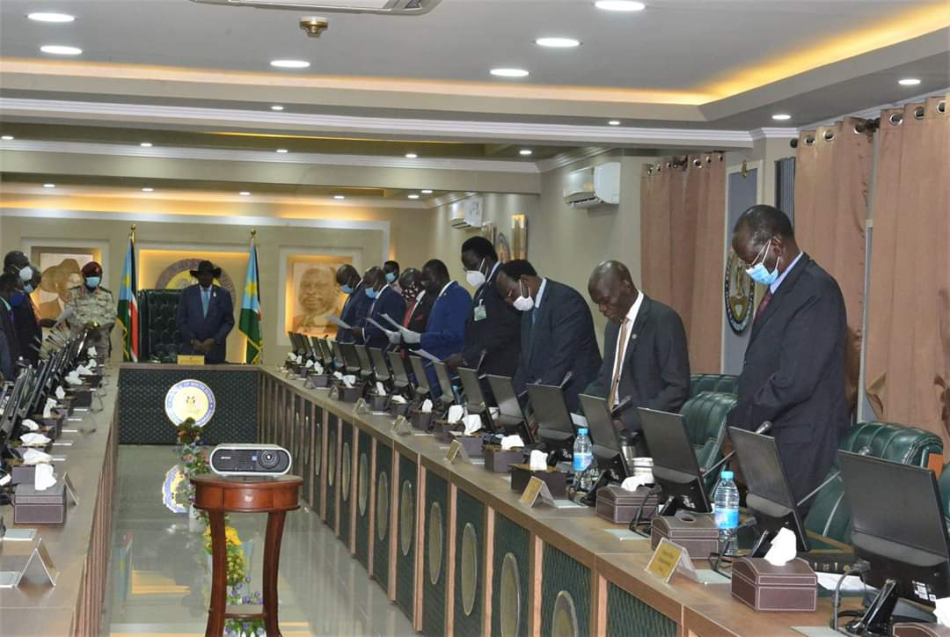
TOGETHER WE CAN !!!
Thanks

